Slide 1


Notes:
Good morning everyone, today I am here to talk to you about how important it is that we take care of our air.

Slide 2
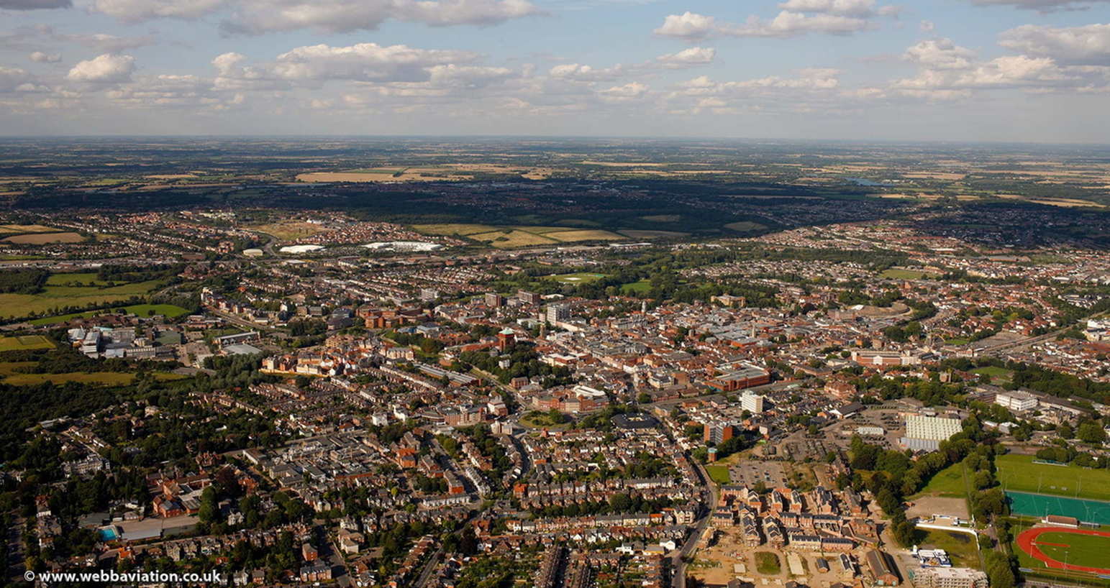
Notes:
Firstly, I'd like you to have a look at this photo of Colchester and think about whether the air looks clean or dirty. Hands up if you think it looks clean, and hands up if you think it look dirty?
I think it does look quite clean, but that doesn't mean that there isn't any pollution in the air. Air pollution particles are very small, too small for our eyes to see and we can't always smell it so it can be difficult to know if air pollution is there.

Slide 3
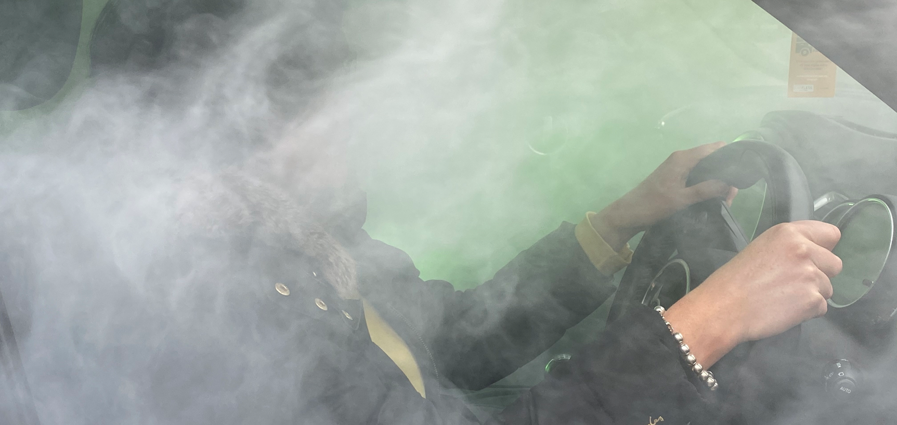
Notes:
If the particles were big enough for us to see, it might look a bit like this and I don't think any of us would want to breathe this in.

Slide 4

What is air pollution?
Toxic substances in the air
Harmful to humans and other living beings
Most people breathe in air pollution every day
Notes:
So what actually is air pollution?
It is toxic or bad substances in the air and if you are into science, you might recognise some of these including nitrogen dioxide, carbon monoxide and particulate matter.
These substances are harmful to humans but also to other living beings like animals and plants.
Because air pollution is hard to spot, most people unfortunately breathe it in every day without realising.

Slide 5
What do you think causes air pollution?
Notes:
There are lots of different causes of air pollution.
Does anyone want to make a guess about what causes air pollution?
Or hands up if you think XX causes air pollution – cars & buses, trees, burning wood, walking, farming

Slide 6


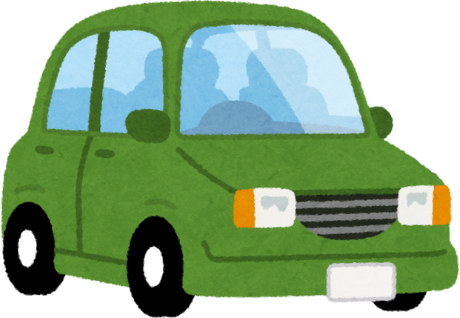

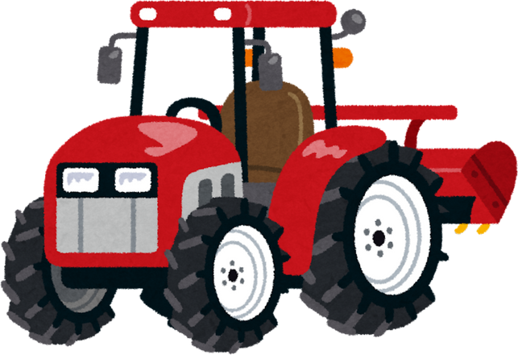


What causes air pollution?
Farming
Cars, vans and lorries
Industry
Burning wood
30% of air pollution is from drivers leaving their engine on when stopped
Notes:
The main cause of air pollution in towns and cities is exhaust fumes from cars, vans, buses and lorries but it can also be produced by industry, farming and burning wood.
30% of air pollution is from drivers leaving their engine on when stopped and this is called engine idling.

Slide 7
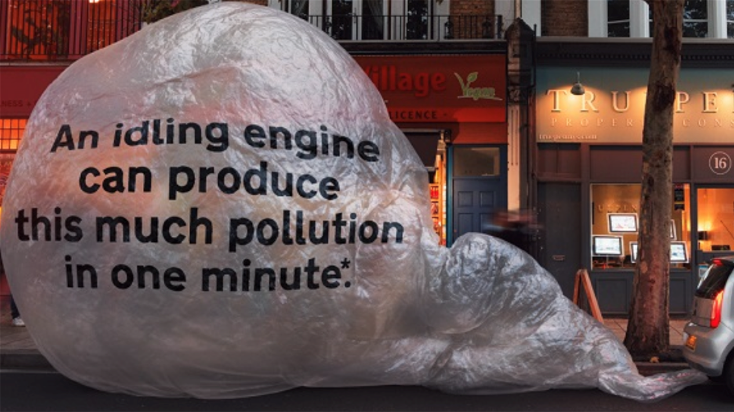
Notes:
An idling engine can produce this much pollution in just one minute! That's a lot of pollution so encouraging drivers turning off their engine when they are stopped is really important. For example, outside schools when your adults are waiting to pick you up.

Slide 8
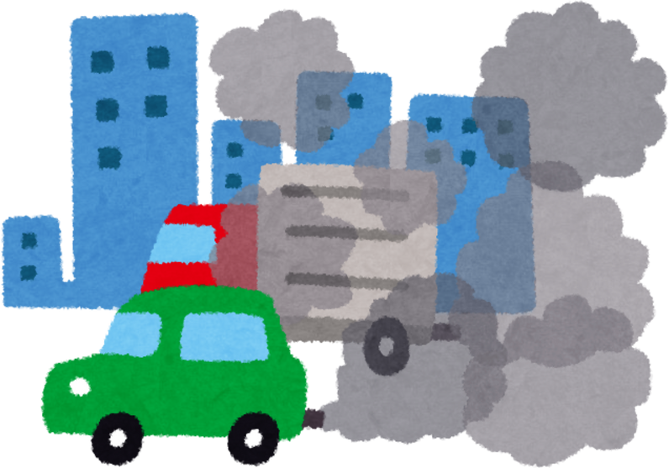
Why is air pollution a problem in Colchester?
Narrow streets mean that the air pollution gets stuck
It builds up and we can breathe it in
Notes:
Why is air pollution a problem in Colchester?
As I am sure all of you know, Colchester is very old city with narrow streets. This means that air pollution can't get blown away by the wind and gets stuck. It builds up and then we breathe it in.

Slide 9
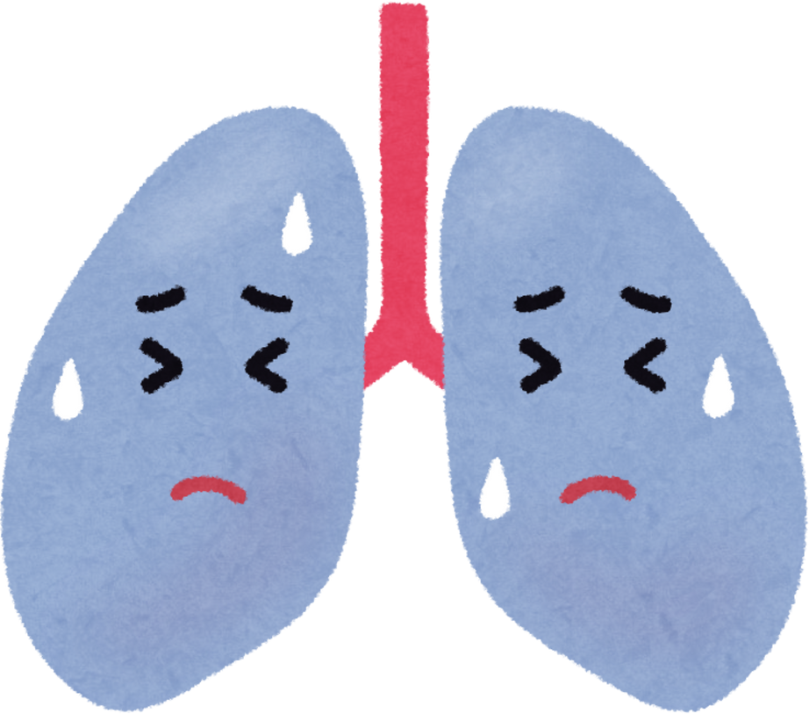
Why is air pollution a problem near schools?
Breathing in air pollution is particularly bad for children
It affects growth and development of your lungs
Notes:
This can be a problem, especially near schools because breathing in air pollution is particularly bad for children. This is because you are still growing and it can affect the growth and development of your lungs and other important parts of your body.

Slide 10


How many times a day do we breathe in?
Notes:
Now, how many times a day do you think we breathe in?
Who wants to put their hand up and make a guess?

Slide 11
How many times a day do we breathe in?
22,000!
Notes:
The actual answer is 22,000 times a day! So you can see why is it really important that we are breathing in clean air not dirty air.

Slide 12

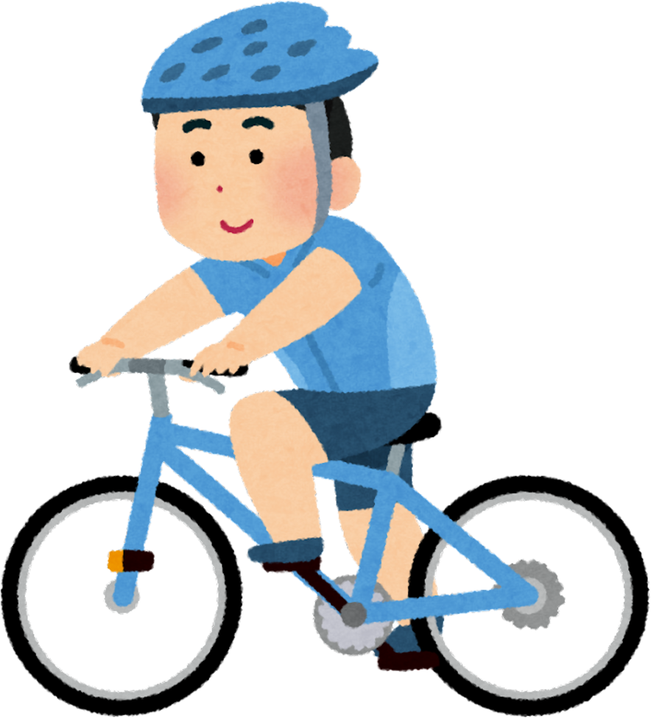
What could you do to help take care of our air?
  Think about how you travel
  Look out for each other
  Tell others about what you have learnt
Notes:
This assembly is part of the work to help spread the message about taking care of our air to as many people in Colchester as possible to help you to take action! So here are some things that you could do:
Think about how you travel, whether this is to school, to see your friends and family, to the shops or into the city centre. Can you walk, cycle or take the bus instead? If you are going in a car, can you remind your adults to switch of the engine when you are stopped?
Look out for each other, no matter how you are travelling, you should show respect and be patient with other people on the pavement and road by waiting for the green man to cross, cycling safely by signing up to do your Bikeability training and when you are in a car, reminding your adults to give cyclists plenty of space.
Tell others about what you have learnt to help share the message.
Hands up if you think you can XX – ask you adults to turn the car engine off when you are stopped, walk, cycle or scoot for short journeys, do your bikeability training.
It would be amazing if all of you could do just one thing to help our air.

Slide 13

Notes:
Our individual actions might seem small but together they will make a big difference. If we take sand as an example, each grain of sand is really small, but when you have lots of sand together, you get a lovely sandy beach and that is what it is like when everyone works together to take action to help take care of our air.

Slide 14
Thank you for Listening!
Notes:
Thank you everyone for listening and being an amazing audience!

